Slide 1
CASE STUDY - TechRetail
Nandini
Shivani
Harsha Priya

Slide 2
Background
TechRetail, a mid-sized retail company, wants to create a data pipeline to collect retail data from various sources, process it using advanced analytics, and visualize the results in a dashboard. The goal is to gain insights into sales trends and improve decision-making. The company wants to leverage Azure Databricks for data processing and Microsoft Fabric for data integration and visualization.

Slide 3
Solution Architecture
Data Sources
Data Ingestion
Data Processing
Data Storage
Data Visualization

Slide 4
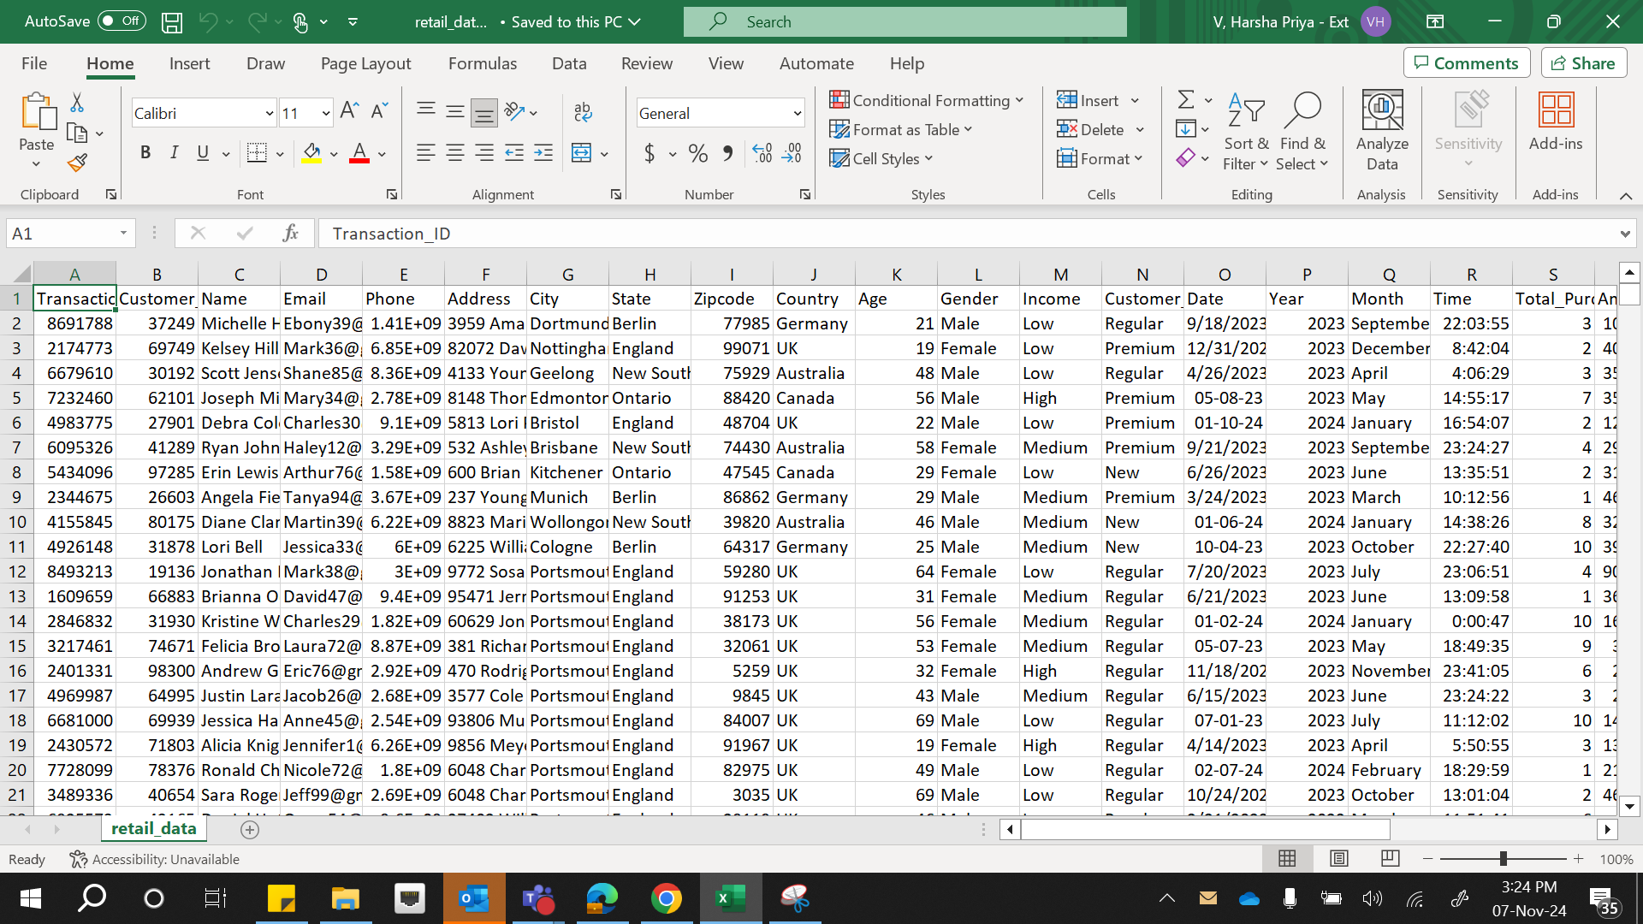
Data Set

Slide 5
This dataset contains over 300,000+ retail transactions, capturing key customer and product information, including customer IDs, names, product IDs, transaction dates, and addresses etc . It provides insights into purchasing patterns, product performance, and customer behavior. The data is ideal for analyzing trends, forecasting sales, and improving customer segmentation.

Slide 6
Data Ingestion using Databricks
Setting up a Databricks workspace
Once workspace is ready, we can create a Spark cluster in Databricks.
To ingest data into Databricks, we can connect it to various data sources, such as Azure Blob Storage.

Slide 7
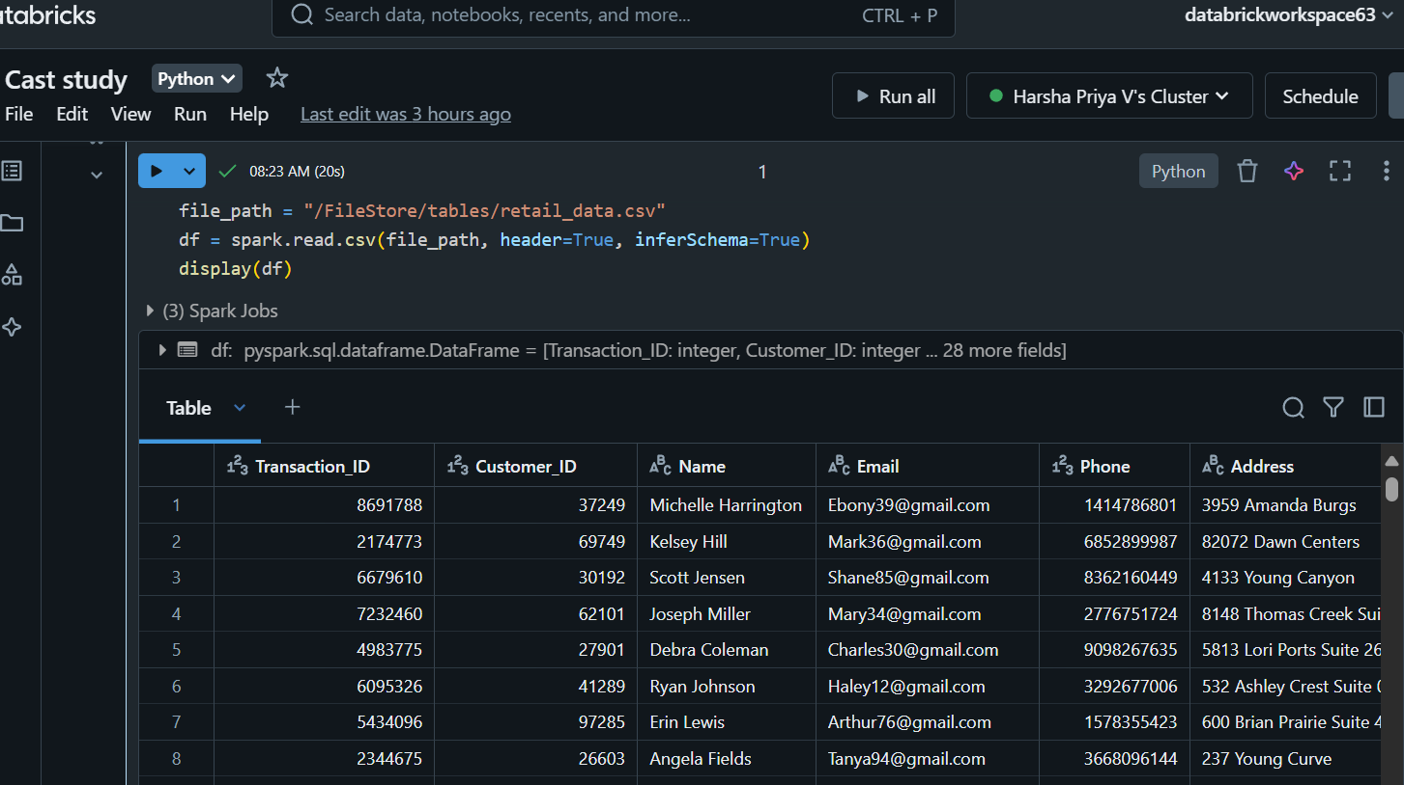
Data Ingestion using Databricks

Slide 8
Data Transformation and Cleaning
Handling Missing Data (Null values)
Removing Duplicates
Date Formatting
Round to N Decimal Places

Slide 9
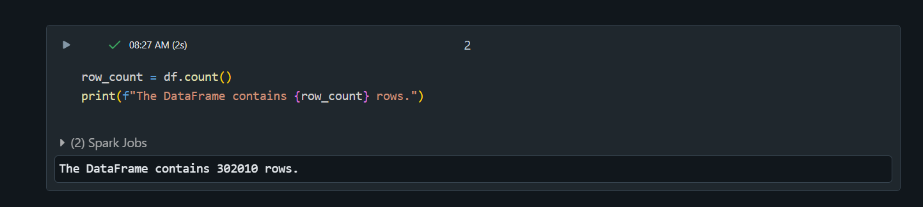
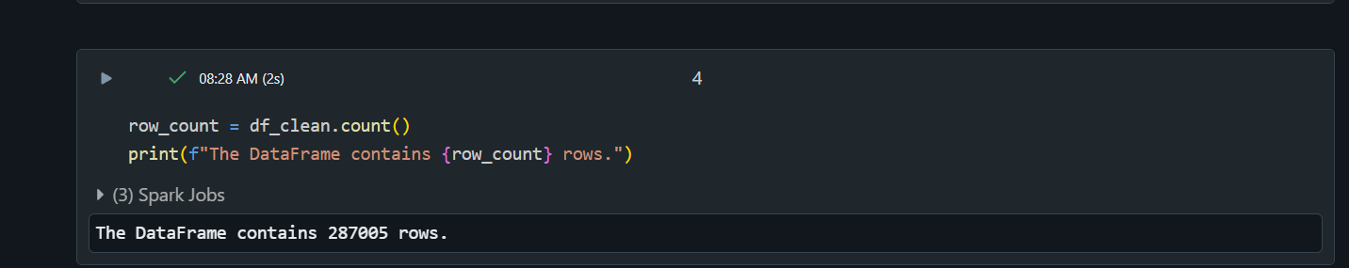
After Removing Null and Duplicates
Raw Data

Slide 10
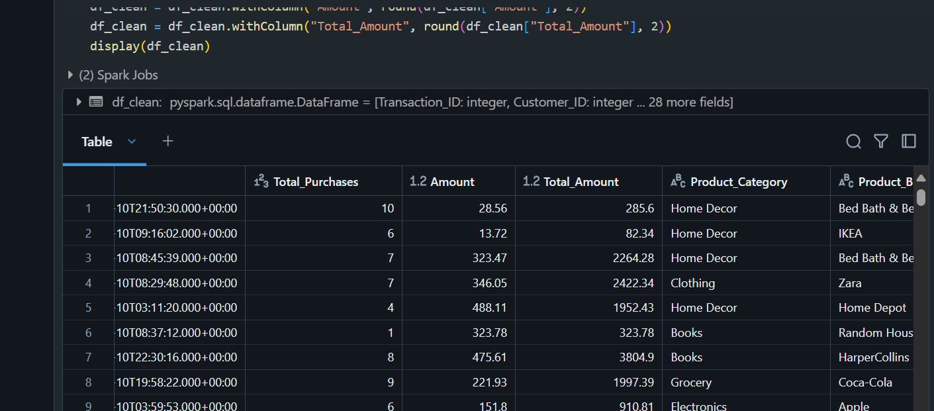
Round to N Decimal Places

Slide 11
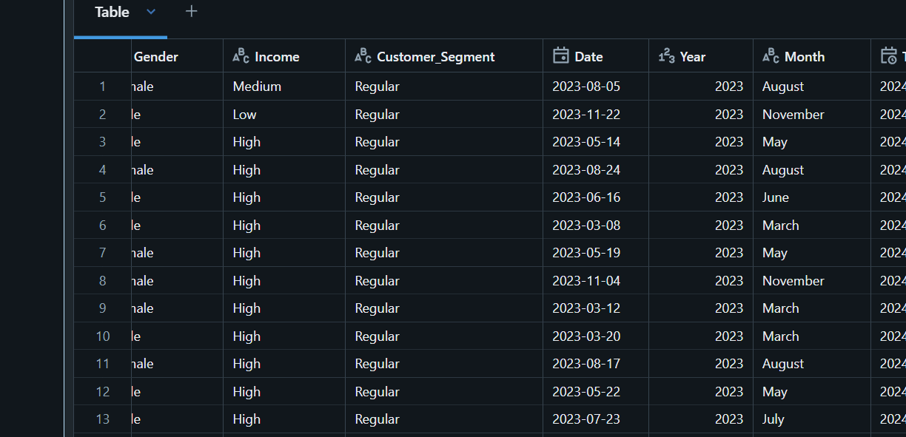
Date Formatting

Slide 12
Data Processing using Databricks
Azure Databricks is used to process the data using Apache Spark, a powerful distributed computing engine.
After the data is ingested into Azure Blob Storage , the next step is to load this data into Azure Databricks.
Azure Databricks is integrated with these storage solutions, making it easy to read the data directly from Blob Storage into a Databricks notebook for processing.

Slide 13
Data Storage using Azure Blob Storage
The processed data is typically saved in a structured format, such as Parquet, Delta Lake, or CSV, and stored back in Azure Blob Storage

Slide 14
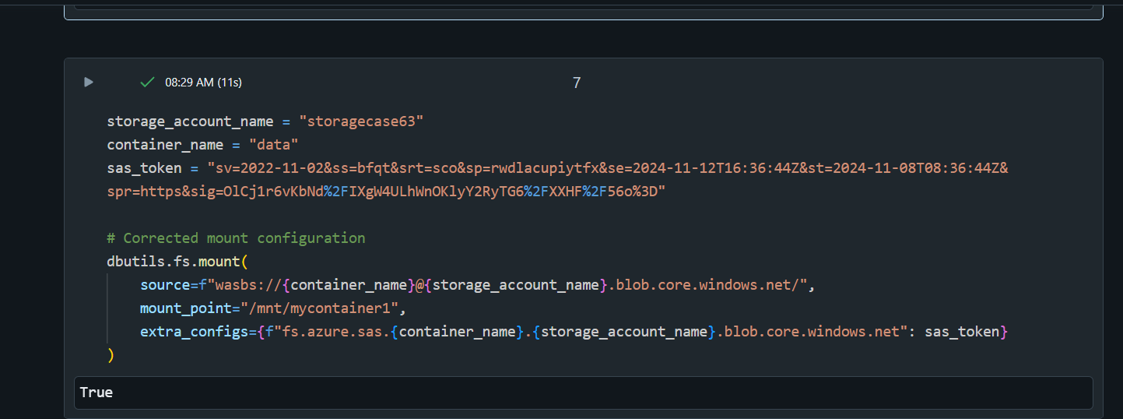
Data Storage using Azure Blob Storage

Slide 15
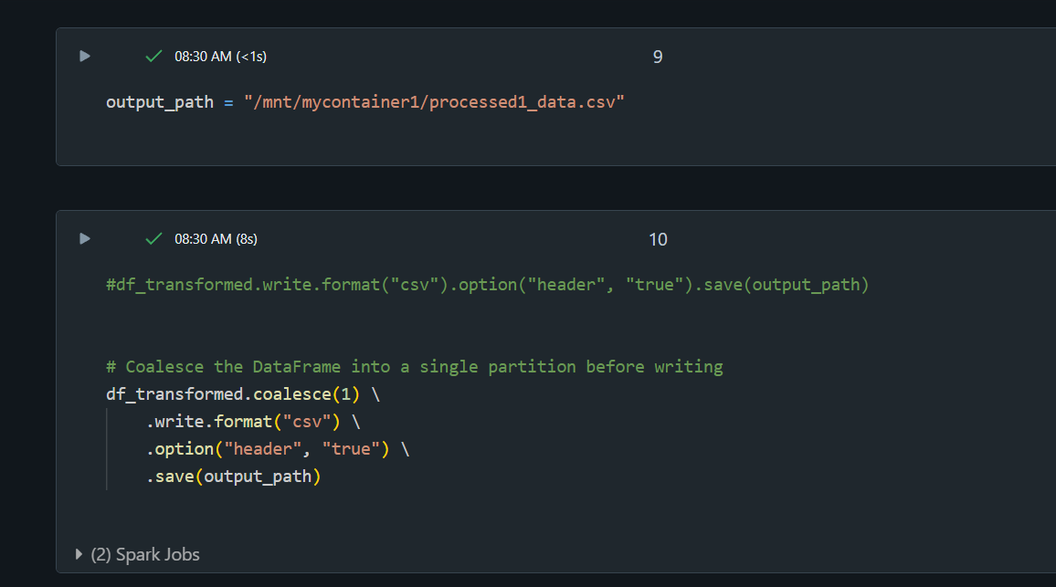

Slide 16
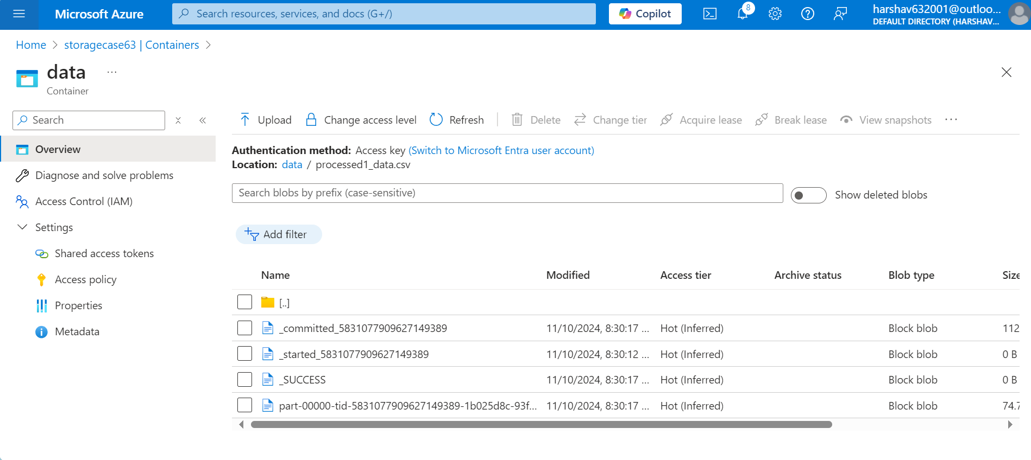

Slide 17
Data Visualization using Microsoft Fabric
Data Visualization phase involves creating interactive dashboards, reports, and analytics from the processed data stored in Azure Blob Storage.
After the raw data is transformed and stored, Microsoft Fabric can be used to access, model, and visualize this data for deeper insights and informed decision-making.

Slide 18
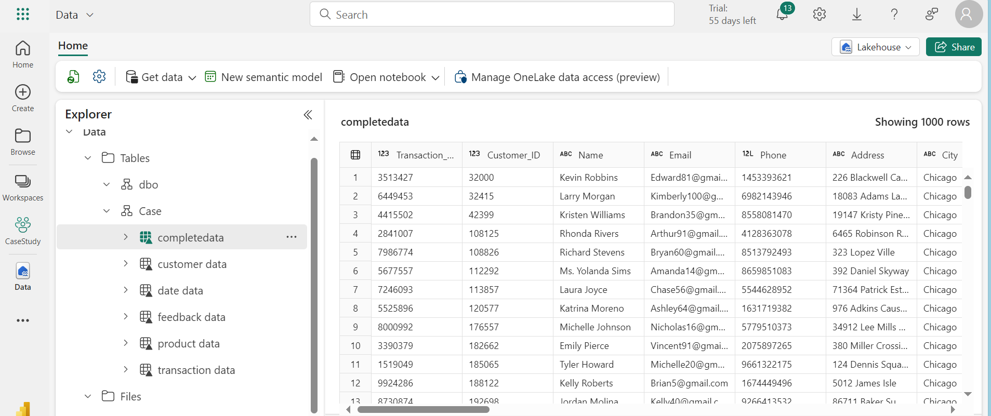
Data Loaded In Lakehouse

Slide 19
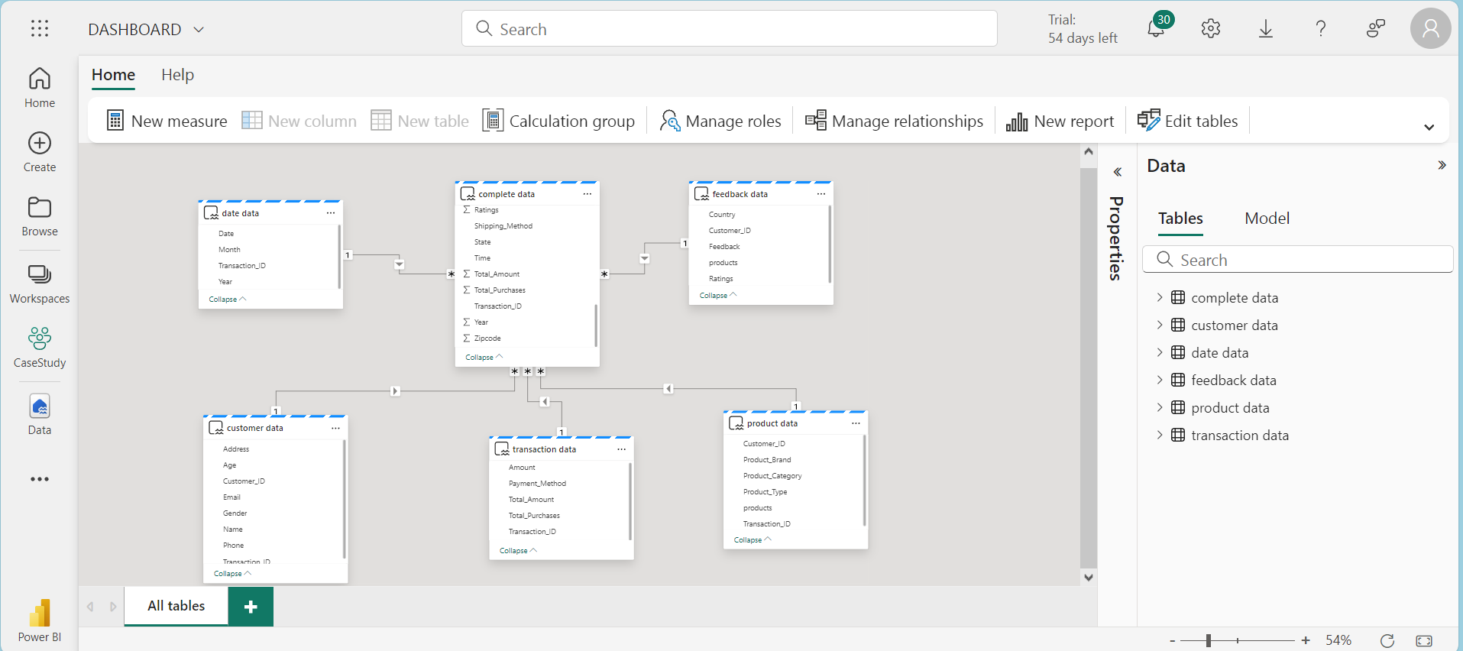
Schematic Model

Slide 20
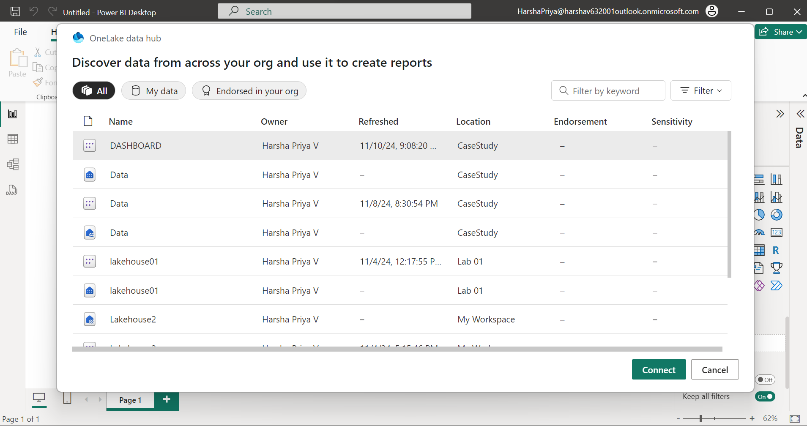
Connecting Onelake to PowerBI Desktop

Slide 21
Expected Output
1. Total Sales per city
2. Total Sales per quarter per year
3. Total products sold per city
4.Average Sales per City
5. Customer Rating Distribution

Slide 22
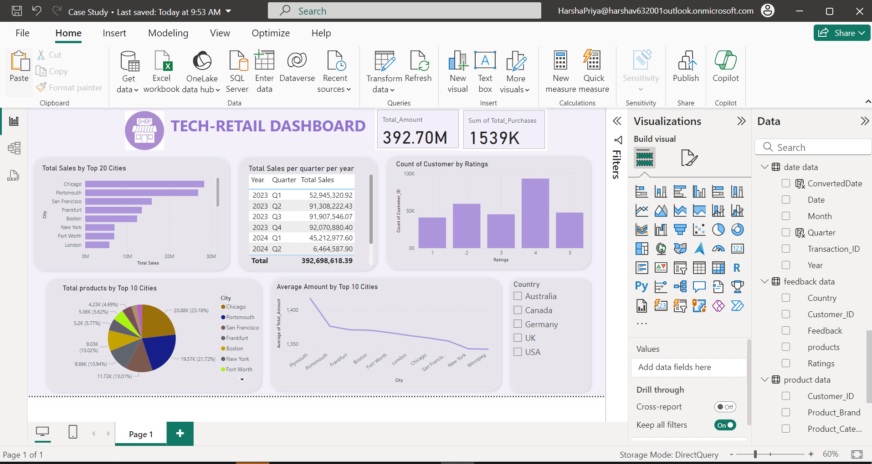
Final Dashboard

Slide 23
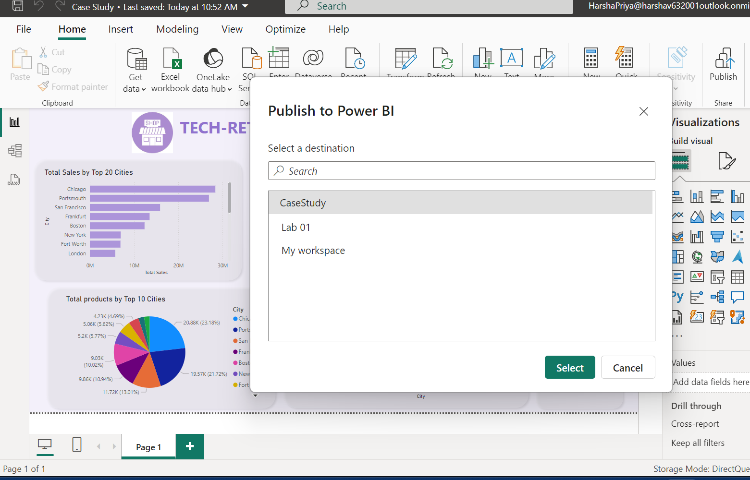
Publish to PowerBI

Slide 24
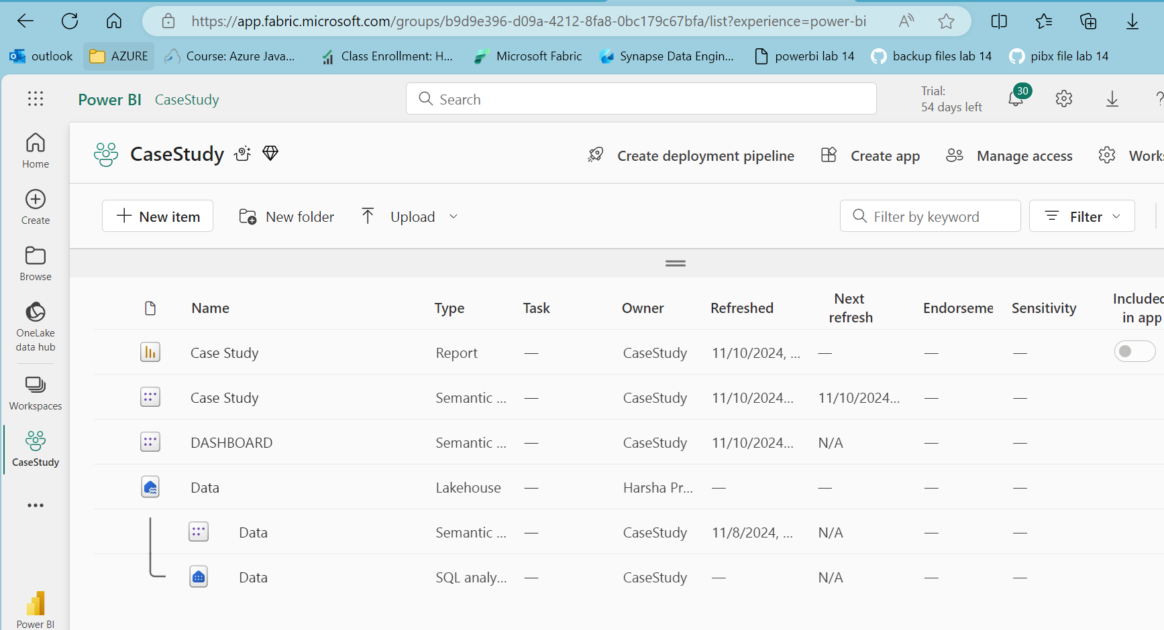

Slide 25
THANK YOU !!

